Slide 1
Metódy a výhody gamifikacie úloh na príklade Habitica

Slide 2
Obsah
Tabuľka
Graf

Slide 3
Tabuľka
ID | Country | Number of users | Percentage
1 | India | 329,65 | 28,98
2 | US | 179,65 | 15,79
3 | Indonesia | 129,85 | 11,41
4 | Brazil | 116,00 | 10,20
5 | Mexico | 89,70 | 7,89
6 | Philippines | 82,85 | 7,28
7 | Vietnam | 70,40 | 6,19
8 | Thailand | 50,05 | 4,40
9 | Egypt | 44,70 | 3,93
10 | Bangladesh | 44,70 | 3,93
 | Sum | 1137,6 | 100,00

Slide 4
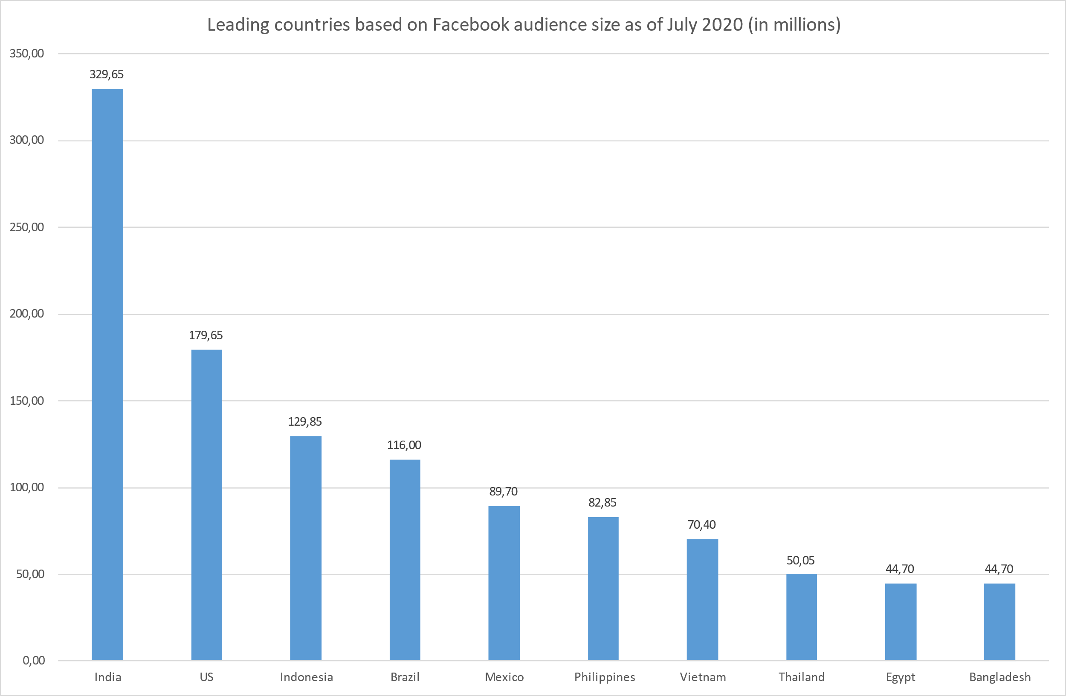
Graf

